Slide 1

Lock Box Control
Yuchen Luo
^{22th May 2023}

Slide 2
Overview
In today's digitally connected world, security is of prior importance. While we've made great strides in securing our digital assets, managing access to physical assets, particularly via keys, still poses a unique set of challenges. These range from loss and theft of keys to lack of efficient systems for access control and difficulty in tracking key usage.
Our project, titled 'The Lock Box', aims to address these issues. The Lock Box is a digital, remotely controllable lock box system that uses modern technologies to provide a comprehensive solution for secure key storage and management.
Through this project, our goal is to create a reliable, secure system that not only simplifies key management but also offers features such as remote management and tracking of key usage, thus increasing convenience and ensuring enhanced security.

Slide 3
Background
Secure key storage is crucial in various sectors, from real estate and property management to infrastructure maintenance and security services. It's essential to have a system that securely manages keys and restricts access to authorized individuals only.
Over the years, key storage has evolved from simple lock-and-key systems to digital lock boxes. However, existing solutions still have limitations. For example, traditional lock boxes do not allow remote access management and do not track key usage. More modern digital solutions may still lack user-friendly interfaces, efficient tracking mechanisms, or robust security features.
So, the need of the hour is a secure, user-friendly, and remotely manageable key storage solution."

Slide 4
The idea
Introduction of the Lockbox project: Present the project as an innovative smart lock box solution that uses a blend of hardware and software technologies for key storage and access control.
Explanation of how it addresses the problems identified: Highlight how the project improves upon traditional systems by offering secure storage, issuing unique codes for access, allowing remote control, and maintaining logs of each access attempt.
The Lock Box project is a secure, digital, and remotely controllable key storage system. It was conceived to overcome the identified limitations of existing solutions.
The Lock Box uses cutting-edge technologies to offer a comprehensive key management system. It allows for remote management of access, generates unique codes for access, tracks key usage, and employs various security measures to prevent unauthorized access

Slide 5
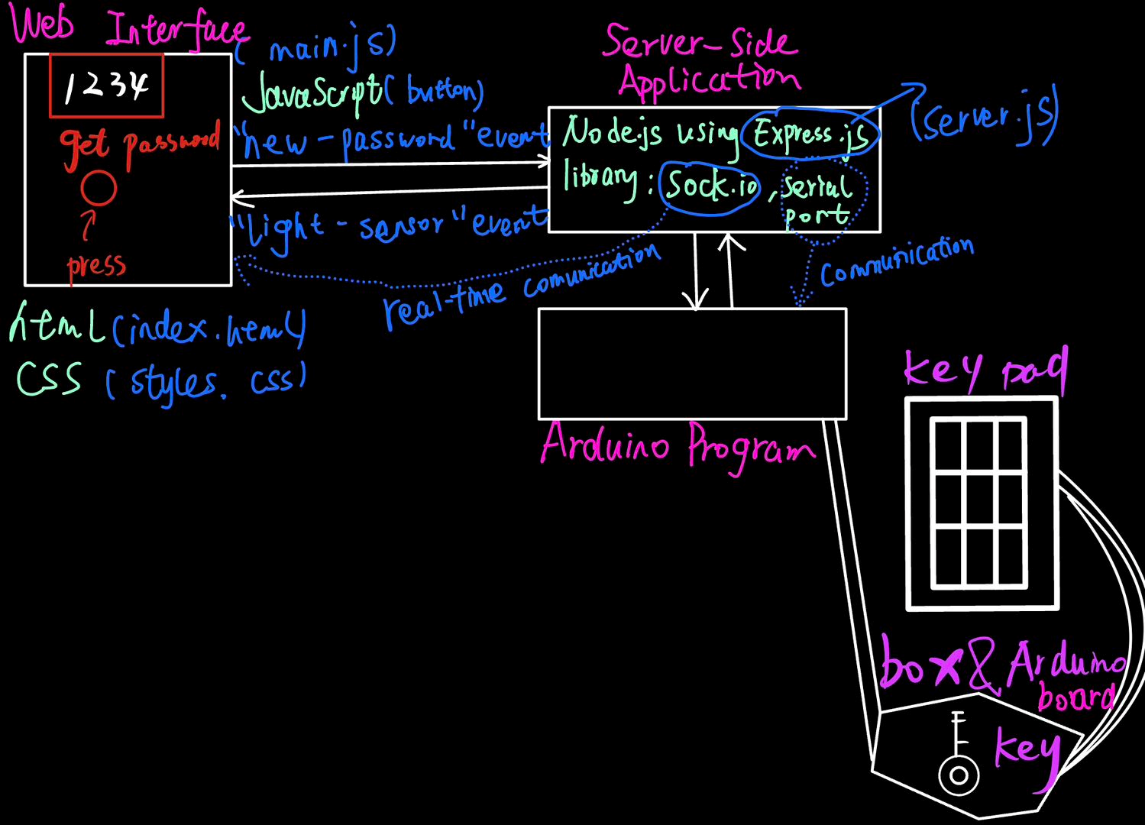
System Overview
[图片]
[图片]
Our system consists of several components that work together to provide the desired functionality. From the physical lock box with integrated keypad to the central server handling access control and the user interface accessible from any web browser, each piece plays a vital role.

Slide 6
Key Components
Identification of the project's key components: The system primarily relies on the Arduino board, a numeric keypad for access, a Node.js server with Express.js for hosting the web application, and Socket.io for real-time communication.
Brief explanation of the role of each component:
Arduino board: Interfaces with the keypad and controls the lock box based on commands received from the server.
Numeric Keypad: Used by the authorized user to enter the access code.
Node.js Server: Hosts the application that allows for remote control of the lock box. It also generates unique access codes and manages their duration of validity.
Socket.io: Enables real-time communication between the web client and server.

Slide 7
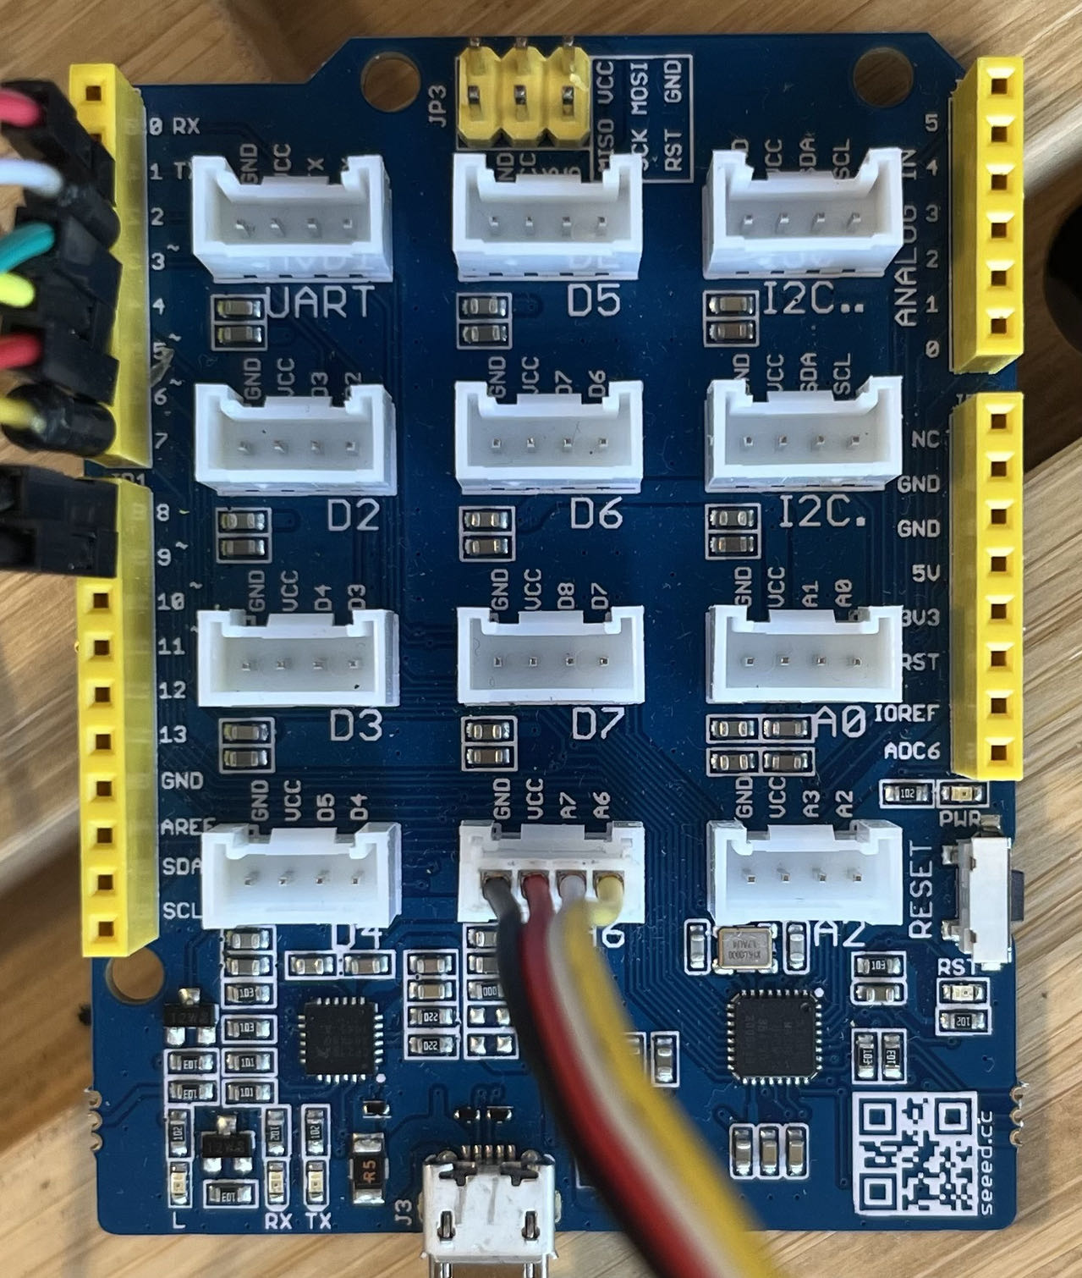
Arduino
Arduino is an open-source electronics platform based on easy-to-use hardware and software, known for its flexibility and low cost.
The Arduino board, which is equipped with a microcontroller, has been used due to its extensive support and ease of integration with other components like the keypad.

Slide 8
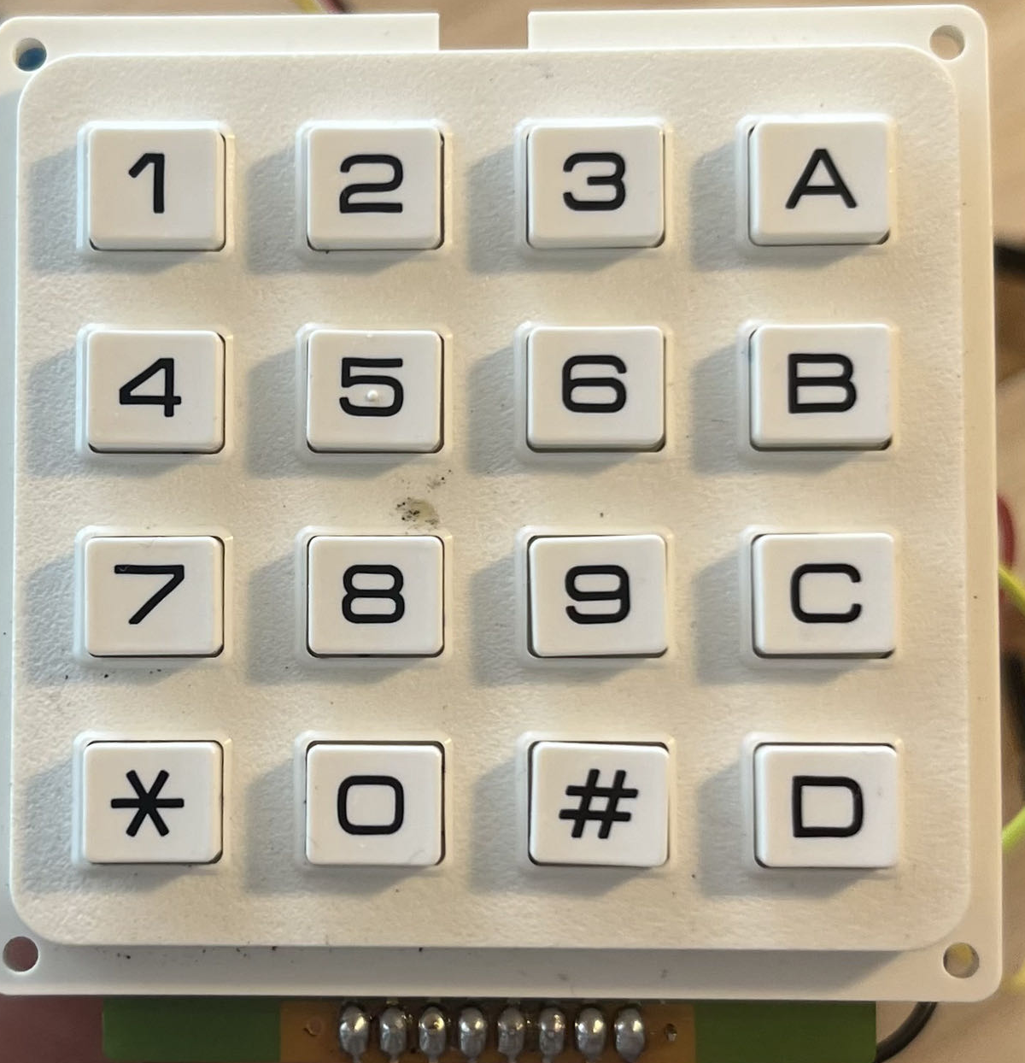
Keypad
We have used a standard numerical keypad for entering access codes. The keypad is directly interfaced with the Arduino board, and it allows users to input their unique codes for gaining access to the keys stored in the Lock Box
When the correct passcode is entered into the keypad, it sends a signal to the Arduino board, which then unlocks the lock box if the entered code matches the code issued by the server.

Slide 9
Node.js and Express.js
Node.js is a JavaScript runtime that executes JavaScript code outside a web browser, while Express.js is a minimal and flexible Node.js web application framework that provides robust features for web and mobile applications.
The Node.js server, using Express.js, hosts the web application which issues unique codes for lock box access and manages their validity. It provides an interface for authorized users to request access codes and to remotely control the lock box.

Slide 10
Socket.io
Socket.io is a JavaScript library that enables real-time, bidirectional, and event-based communication between the browser and the server. It played a crucial role in ensuring the instant delivery of access codes and reporting the lock box status back to the server
In this project, Socket.io is used for real-time communication between the web server and the client. It enables the server to issue an access code to the client and to update the client on the status of the lock box in real-time.

Slide 11
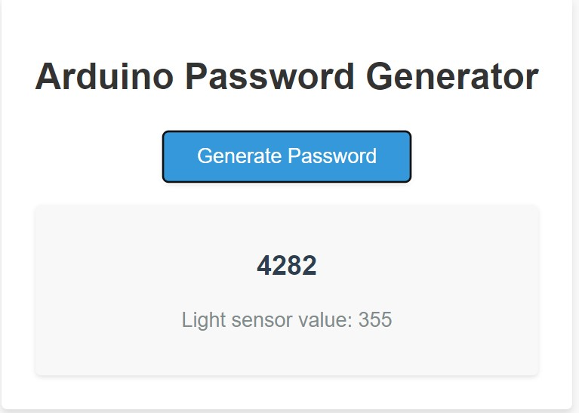
Frontend (HTML, CSS, JavaScript)
HTML is used to structure a web page, CSS is used for styling, and JavaScript is used to make the webpage interactive.
In this project, HTML is used to structure the user interface of the web application. CSS is used to apply styling to the user interface to make it visually appealing, and JavaScript is used to handle user interactions like requesting an access code or updating the lock box status.

Slide 12
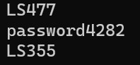
Password Generation Mechanism
The password generation is handled by the server. When an authorized user requests access, the server generates a unique code which is sent to the user. This code is valid for a certain duration, as controlled by the server
When an authorized person requests access, the server generates a unique one-time access code. This code is instantly sent to the user and also to the Arduino for validation when entered on the keypad.

Slide 13
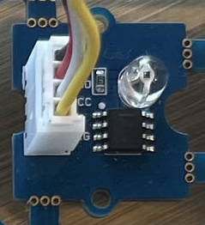
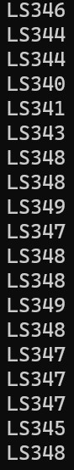
Light Sensor Integration
Run the light sensor:
the lock box is opened, the light sensor detects the change in light levels and triggers a message to the server, recording the event and the time
The value on the website:

Slide 14
Security Considerations
Discussion of the security measures taken in the project: Measures include the use of unique access codes, limiting the duration of code validity, and using secure Socket.io connections for server-client communication.

Slide 15
Challenges Faced
We faced issues with real-time communication, power efficiency, and securing our system. Each challenge was a learning opportunity that helped refine our design and implementation."

Slide 16
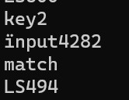
Testing and Validation
The system was thoroughly tested to ensure the correct functioning of the physical components, software modules, and their integration. The tests included validating the communication between the server and the Arduino, ensuring the correct generation and expiration of access codes, and testing the functionality of the keypad and the lock box.

Slide 17
Future Enhancements
Future improvements could include implementing a more complex authentication system for added security, providing options for remote monitoring of the lock box status, and integrating the system with other home automation technologies for increased convenience.
These include integration with smart home systems, user-friendly mobile applications, and advanced security features such as biometric access

Slide 18
Conclusion
"In conclusion, the Lock Box project is our solution to the need for a secure, user-friendly, and remotely manageable key storage system. We've combined hardware and software technologies, faced and overcome various challenges, and learned valuable lessons along the way.“
This project successfully demonstrated a secure and convenient solution for key access control using an Arduino, a keypad, and a web server.
The Lock box project has potential for further development and could be an innovative solution in the home security market.

Slide 19
Questions and Answers

